Slide 1


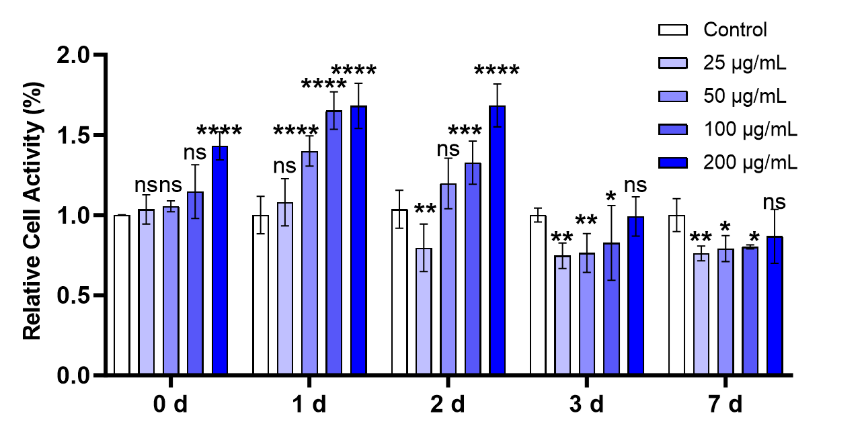
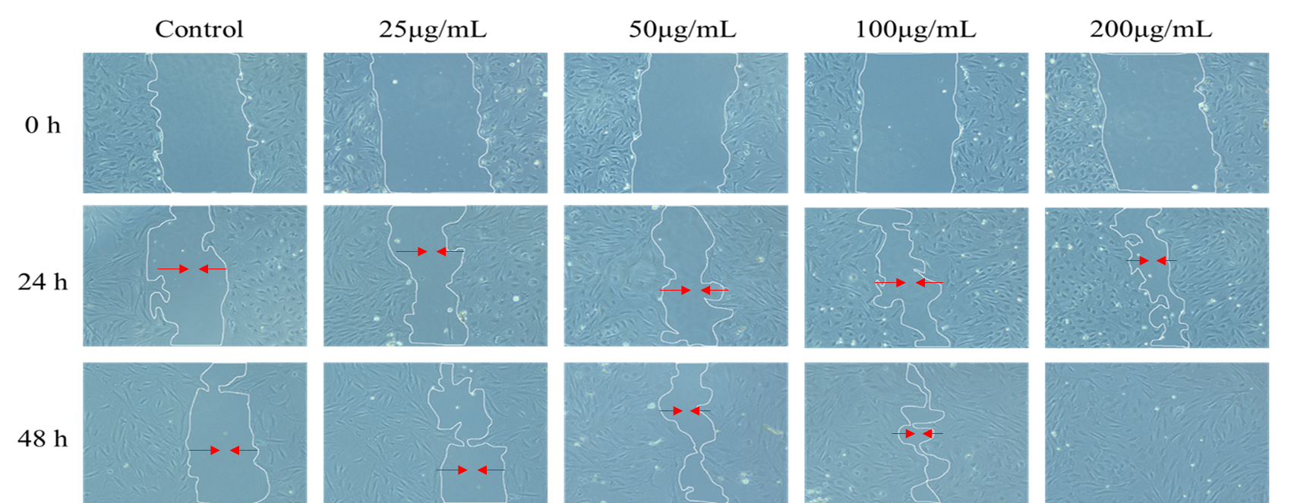
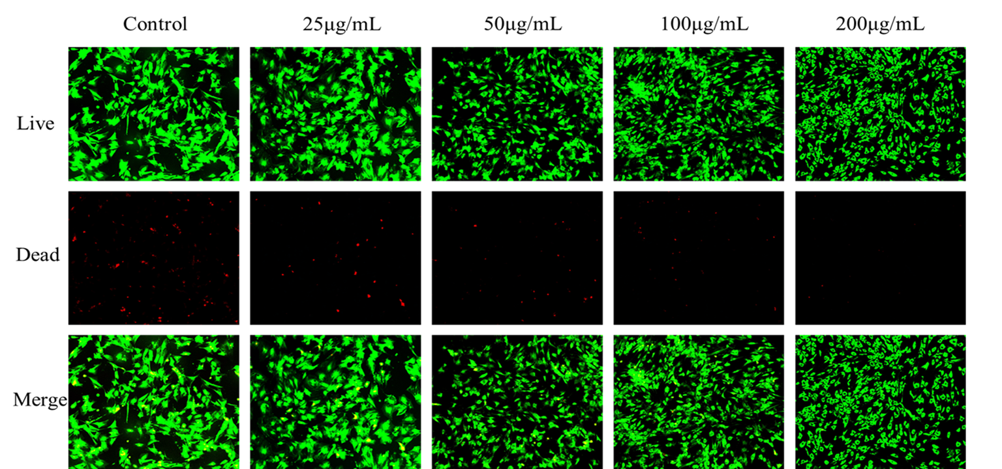
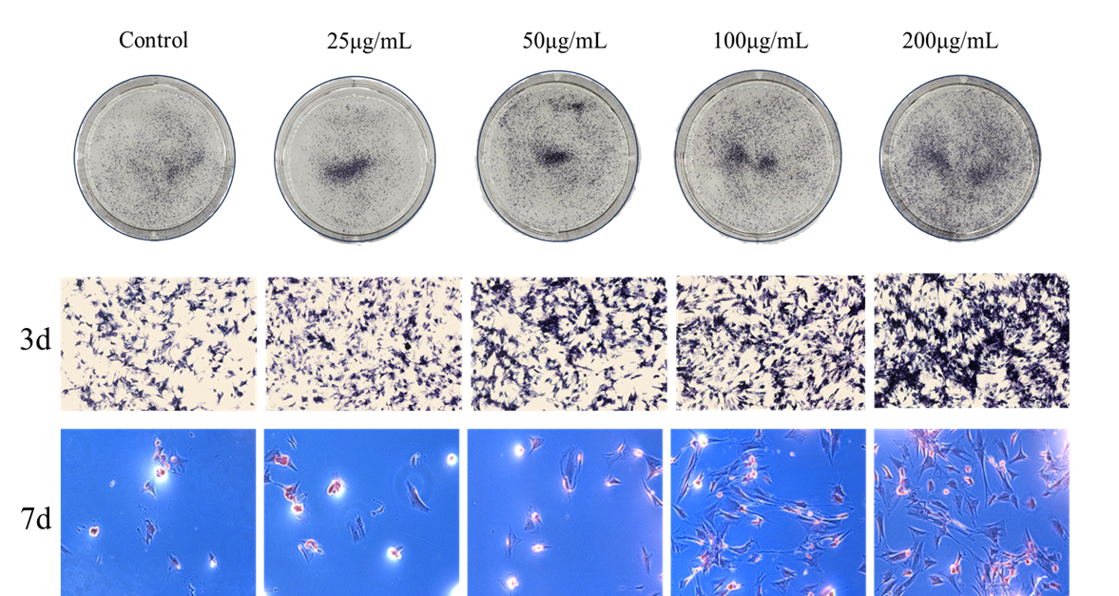
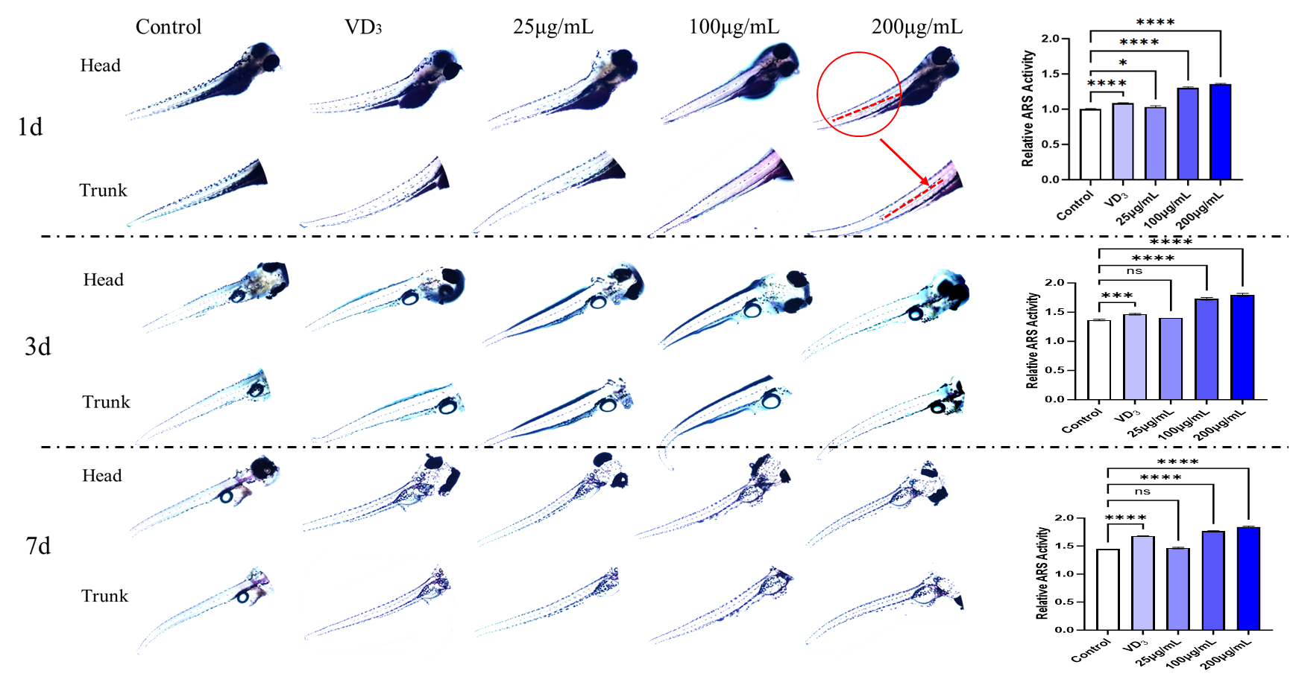
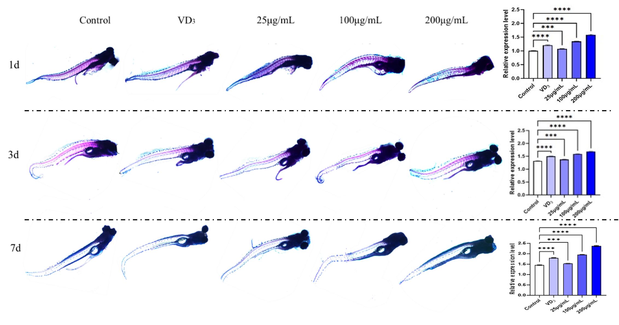
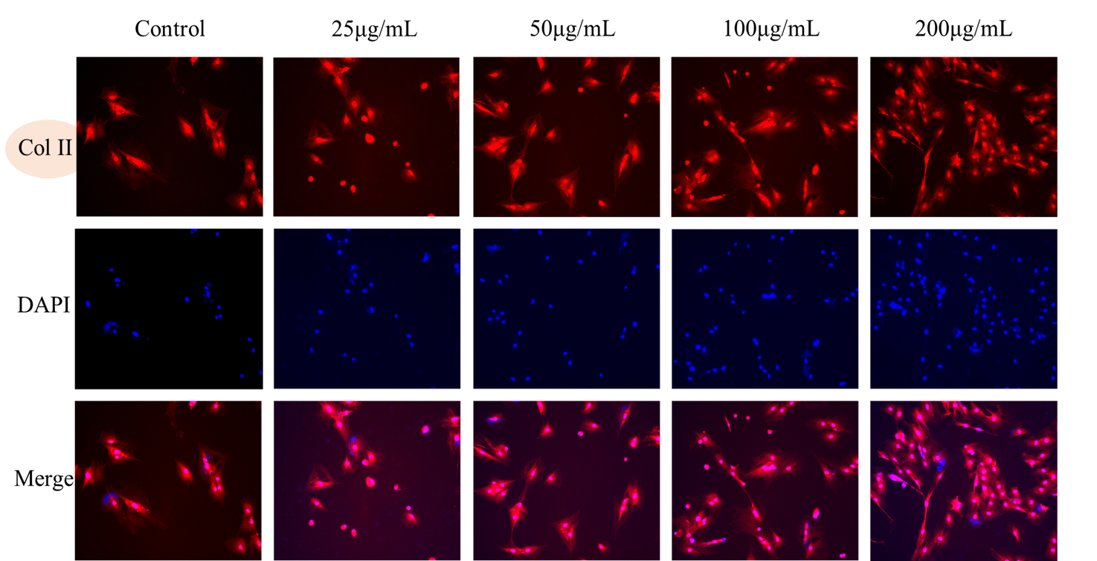
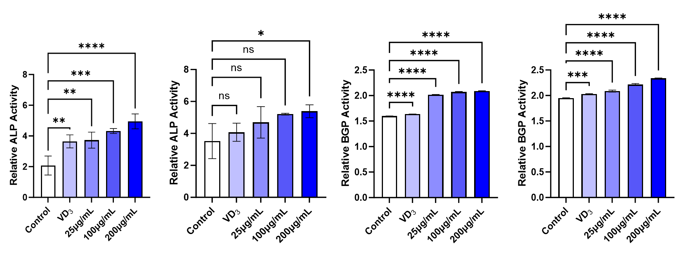
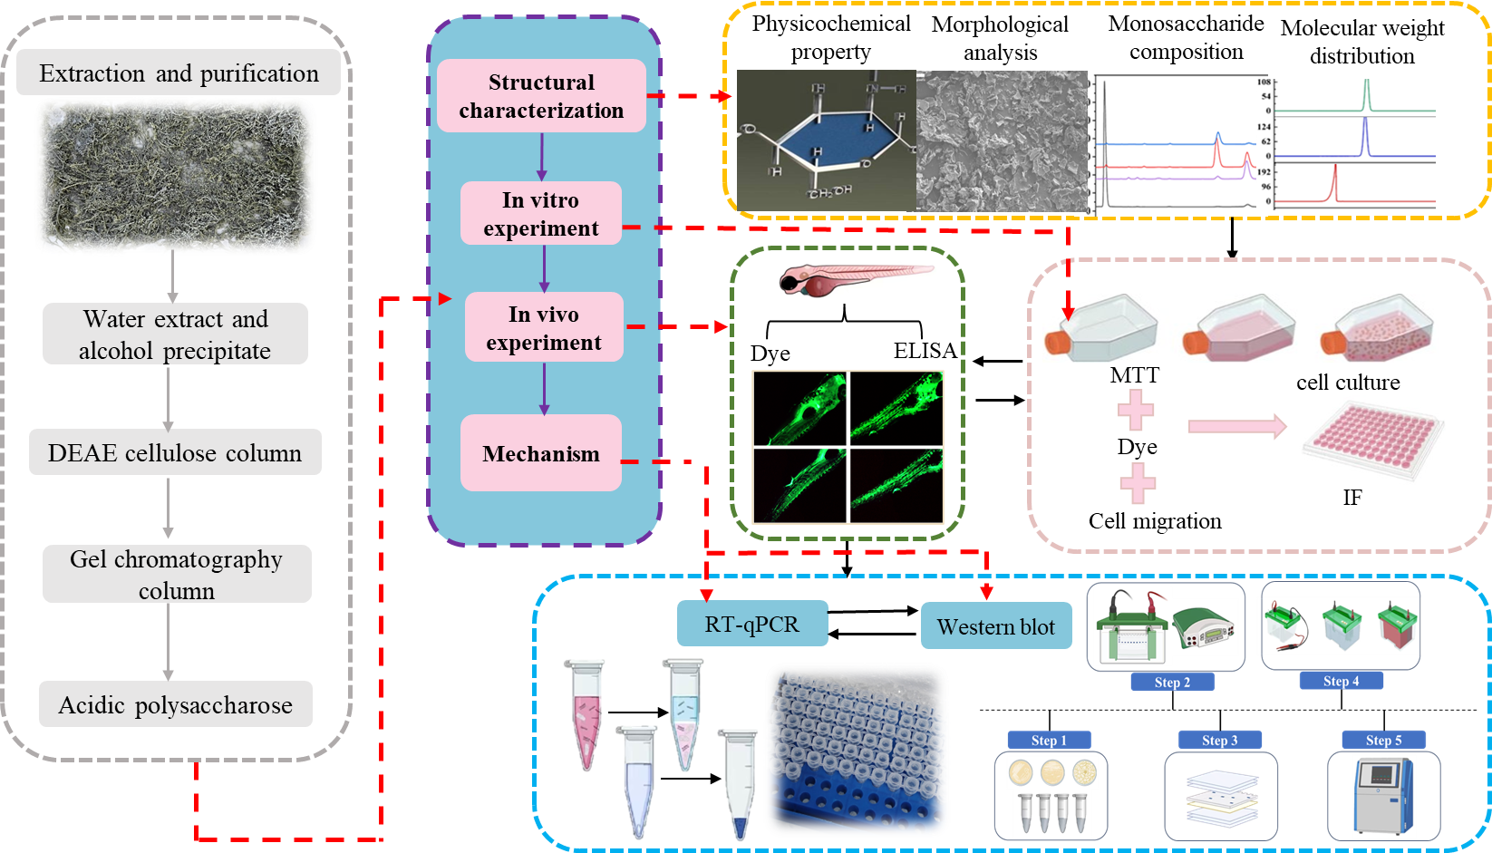
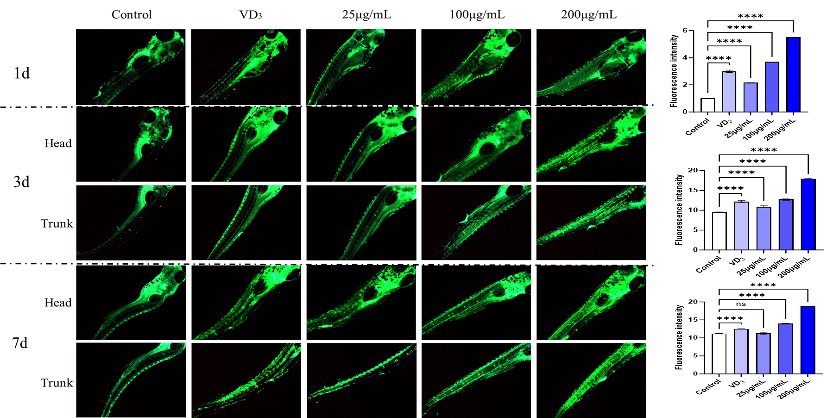
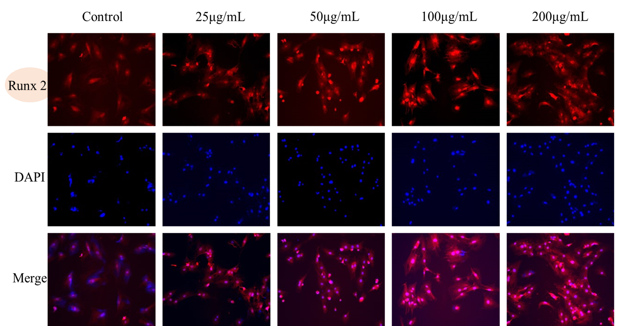
Unraveling the osteogenic activity of Sea Grapes (Caulerpa lentillifera ) acidic polysaccharides: from structural features to molecular targets
FSMILE 2025
October 04-07, 2025
@Morioka & ZOOM Cloud
Zijing Lu¹, Yue Wan¹, Zhiheng Hu², Songqi Liu³, Dongxue Wang¹, Yaqin Hu^{1*}
1 College of Food Science and Engineering, Yazhou Bay Innovation Institute, Hainan Tropical Ocean University, Marine Food Engineering Technology Research Center of Hainan Province, Collaborative Innovation Center of Marine Food Deep Processing, Hainan Key Laboratory of Herpetological Research, Sanya 572000, China
2 United Graduate School of Agricultural Sciences, Ueda 3-8-18, Morioka, Iwate 020-8550, Japan c Faculty of Agriculture, Iwate University, Ueda 3-8-18, Morioka, Iwate 020-8550, Japan
3 Sanya Oceanographic Institution, Ocean University of China, Sanya 572024, China
International Symposium on Food Communications and Sustainable Agri-Aqua Food Systems
Connecting Primary Industries, Academia, and Society through the SDGs
Contact Information: qqzj37@163.com. (Zijing Lu).
Introduction
As global aging accelerates, bone health issues like osteoporosis and bone defects are increasing dramatically.
Polysaccharides are a type of biological macromolecule with extensive pharmacological activities.
Algae are rich in bioactive substances. Separating these active substances from seaweed has become a new development trend.
Results
Conclusions
1. CLAP can enhance the migration ability of BMSCs and have a positive impact on cell metabolism and growth.
2. CLAP significantly promote the proliferation, migration, survival and osteogenic differentiation of BMSCs, and possess significant osteogenic activity.
3. CLAP can enhance the mineralization ability of zebrafish, promote cartilage formation, and increase the synthesis of osteocalcin.
Figure 1. Cell viability of BMSCs cultured with polysaccharides determined by MTT assay.
Figure 2. Migration ability of BMSCs cells cultured with polysaccharides at 0 h, 24 h and 48 h.
Figure 3. AO/EB dual fluorescence staining image of BMSCs cells.
AIM
To explore the potential of Sea Grapes acidic polysaccharides (CLAP) as a functional food additive from natural sources, providing theoretical basis and key technical parameters for the field of bone tissue and the development of novel marine-derived osteogenic materials.
CLAP promoted BMSCs proliferation within a certain concentration range.
At 48 hours, the high-dose group of migration ability nearly closed the scratch completely.
The 100 and 200 μg/mL groups of AO/EB dual fluorescence staining showed the best cell survival and morphology, with clear cell-cell connections.
CLAP strongly promote osteogenic differentiation from early to late stages.
The expression levels of RUNX2 and Collagen II in BMSCs were increased.
Acknowledgements
This work was financially supported by Scientific Research Foundation of Hainan Tropical Ocean University (RHDRC202117 and RHDRC202307).
Method
Characterized their structure using various methods, including molecular weight analysis, monosaccharide composition, and microscopic imaging.
To evaluate osteogenic effects of CLAP, we used rat bone marrow stem cells and zebrafish embryos.
Used RT-qPCR to measure gene expression and western blot to analyze protein changes in the PI3K-AKT pathway.
Figure 4. ALP staining and ARS staining of BMSCs cells.
References
[1] Lu Y S, Zhou T, Shabbir I, et al. Marine algal polysaccharides: Multifunctional bioactive ingredients for cosmetic formulations[J]. Carbohydrate Polymers,2025,353123276-123276.
[2] Yingying F, Teketay W, Renyou G, et al. Structural characteristics and immunomodulatory effects of sulfated polysaccharides derived from marine algae. [J]. Critical reviews in food science and nutrition,2022,63(24):11-17.
[3] Mengjie R, F. A A, Meng L, et al. A review: the mechanism of plant-derived polysaccharides on osteoblasts and osteoclasts[J]. Journal of Future Foods,2024,4(3):183-192.
[4] D. A P, A.E. T A, Garima K, et al. Polysaccharides from red seaweeds: Effect of extraction methods on physicochemical characteristics and antioxidant activities[J]. Food Hydrocolloids,2024,147(PA)
[5] Pereira G F C, Bezerra G E M L, et al. Role of sulfated polysaccharides from seaweeds in bone regeneration: A systematic review[J]. Carbohydrate Polymers,2022,284119204-119204.
Figure 7. ARS staining image of Zebrafish embryos.
Figure 8. Alcian Blue staining image of Zebrafish embryos.
Figure 5. Immunofluorescence staining image of BMSCs cells.
Figure 10. The content of ALP and osteocalcin (BGP) after 3d and 7d.
The high-dose group had stronger mineralization than the positive control.
CLAP enhanced the degree of bone mineralization in vivo.
ALP activity and BGP levels both increased with CLAP concentration and over time.
Figure 6. Immunofluorescence staining image of BMSCs cells.
Figure 9. Calcein AM staining image of Zebrafish embryos

